Slide 1
Adenocarcinoma of the Esophagus and GE Junction

Slide 2

Anatomy
Food moves from the throat
$→$ esophagus
$→$ stomach
$→$ small bowel (jejunum)

Slide 3
Cancer Staging
Staging refers to the tests to determine
How large is the tumor?
Has there been spread to lymph nodes?
Has it spread to other parts of the body?
Treatment options depend upon the cancer stage

Slide 4
Cancer Staging
T = Tumor - Depth of growth into the wall
N = Nodes - Spread to the lymph nodes
M = Metastasis - Spread to liver, lungs, or bone

Slide 5
Early Stage Cancers
Cancers start on the very inside layer called the mucosa

Slide 6
Locally-advanced Cancers
Over time, cancers can grow into the muscular wall

Slide 7
Lymph Nodes
In some cases, cancer cells can break off from the main tumor and spread to lymph nodes

Slide 8

T Stage
Cancers are categorized based upon the thickness of the tumor, known as the T stage

Slide 9

N Stage
Cancers are categorized by whether there is spread to the nodes.
N0 cancers have not spread to the nodes
N1 cancers have spread to the nodes.

Slide 10

M Stage
Some cancers spread to other parts of the body
M0 cancers have not spread to other parts of the body
M1 cancers have spread lungs, liver, or bone

Slide 11

PET scan
Similar to CT scan
Tracer shows ‘hot spots’
Cancer
Inflammation or infection
Normal organs (heart, kidneys)

Slide 12

Endoscopic Ultrasound
Similar to upper endoscopy (EGD)
Ultrasound in scope
Evaluates T stage

Slide 13

Laparoscopy
Some stomach cancers can spread inside the abdomen
Areas of spread can be very small (grain of rice)
Laparoscopy can detect spread inside the abdomen

Slide 14
Laparoscopy
General anesthetic
Several 1/4” incisions
Telescope examines the abdomen
Biopsies can be performed.

Slide 15
Treatment Plan
Superficial (T1)
Endoscopic Therapy
Localized (T1b/T2)
Surgery (esophagectomy)
Locally-advanced (T3M0)
Chemo$±$Radiation $→$Surgery
Metastatic (M1)
Chemotherapy

Slide 16

Locally-advanced cancers
Patients with locally-advanced esophageal cancer often have localized spread of cancer cells in the surrounding area

Slide 17

Locally-advanced cancers
If locally-advanced cancers are treated with surgery alone…

Slide 18

Locally-advanced cancers
If locally-advanced cancers are treated with surgery alone…
There is a risk that cancer cells can be left behind

Slide 19
Preoperative Therapy
It is helpful to start with therapy before surgery that will shrink the cancer.

Slide 20

Preoperative Therapy
It is helpful to start with therapy before surgery that will shrink the cancer.

Slide 21

Preoperative Therapy
It is helpful to start with therapy before surgery that will shrink the cancer.

Slide 22

Surgery after Preoperative Therapy
When surgery is then performed…

Slide 23

Preoperative Therapy
When surgery is then performed…
The risk of cancer recurrence is minimized

Slide 24

Preoperative Therapy
When surgery is then performed…
The risk of cancer recurrence is minimized

Slide 25
Chemotherapy + Radiation CROSS Trial
363 patients with esophageal cancer studied
Patients were treated in two groups:
Surgery Alone
vs
Chemo + Radiation $→$ Surgery

Slide 26
Chemotherapy + Radiation CROSS Trial
363 patients with esophageal cancer studied
Chemotherapy + radiation together over 6 wks
Surgery Alone
vs
Chemo + Radiation$→$Surgery $⇒$ Longer Survival

Slide 27
Chemo + Radiation CROSS Trial
Typical schedule for chemotherapy + radiation:
Chemotherapy once per week for six weeks
Radiation five days per week for six weeks (28)
PET scan (or CT) 4 weeks after the end of radiation
Surgery 8 weeks after the end of radiation

Slide 28
Chemo + Radiation - Side Effects
Kills cancer cells in the esophagus and lymph nodes
Can also irritate the lining of the esophagus.
Swallowing can be difficult the last 2 weeks.
Feeding tube may be needed for hydration/nutrition.

Slide 29
Locally-advanced Adenocarcinoma
“Sandwich” chemotherapy before + after surgery:
Chemo (8 wks) $→$ Surgery $→$ Chemo (8 wks)
Two different drug combinations:
FLOT (more effective)
FOLFOX (better tolerated)

Slide 30
“Sandwich” Chemotherapy Drugs
FLOT
5-FU
Leucovorion
Oxaliplatin
Taxotere
FOLFOX
5-FU
Leucovorin
Oxaliplatin

Slide 31
FLOT Treatment Plan
FLOT Chemo every 2 weeks x 4 (=8 weeks total)
Surgery (4-6 weeks later)
FLOT Chemo every 2 weeks x 4 (=8 weeks total)

Slide 32
Durvalumab Immunotherapy
Cancer cells can turn off immune cells using a protein PD-L1
Darvalumab turns on immune cells by counteracting PD-L1
Durvalumab strengthens the immmune system to fight cancer

Slide 33
Matterhorn Trial
The Matterhorn clinical trial compared two types of treatment:
FLOT $→$ Surgery $→$ FLOT
FLOT + Durvalumab $→$ Surgery $→$ FLOT + Durvalumab
Better survival with addition of durvalumab to FLOT
Treatment with durvalumab depends upon approval from insurance company

Slide 34
FLOT Chemo ± Durvalumab
FLOT Chemotherapy
FLOT (8 weeks)
Surgery (4-6 weeks later)
FLOT (8 weeks)
FLOT + Durvalumab
FLOT + Durvalumab (8 wks)
Surgery (4-6 weeks later)
FLOT + Durvalumab (8 wks)
Durvalumab monthly x10

Slide 35
Adenocarcinoma Treatment Options
Chemo + Radiation
Chemo + Radiation (6wk)
Surgery
Chemotherapy
Chemo (8wk)
Surgery
Chemo (8wk)

Slide 36
Adenocarcinoma Treatment Options
Chemo + Radiation
Longer track record
Better tolerated
Port usually placed
Eating worse $→$ better
May need feeding tube
Chemotherapy
More effective
More side effects
Port always required
Eating slowly improves
Less likely to need feeding tube

Slide 37
Chemotherapy Administration
Most chemotherapy is administered by vein.
Several options exist to administer chemotherapy:
Intravenous catheter in peripheral veins
Peripheral Intravenous Central Catheter (PICC)
Central Venous port

Slide 38

Intravenous Catheter in Peripheral Vein (“IV”)
IV catheter placed in vein of hand or arm
Allows administration of chemo and fluids
Placed for each dose
Removed that day
Not suitable for FLOT chemo

Slide 39

PICC Lines
Placed in Radiology
Stay in place during all of treatment
Needs to be kept clean and dry
Suitable for FLOT chemotherapy

Slide 40

Central Venous Port
Implantable device makes chemo easier
May shower in 24 hrs
No special care at home
OK for FLOT chemo
Allows for blood draws

Slide 41

Central Venous Port
Implanted under skin
Neck incision (1/4”)
Incision below the collarbone
Sutures dissolve
“Superglue” on incisions

Slide 42

Central Venous Port
When it is time for chemotherapy, a needle is inserted through the skin into the port

Slide 43
Restaging
CT or PET scan will be performed after preoperative therapy
Surgery performed after restaging
Timing depends upon recovery from therapy

Slide 44
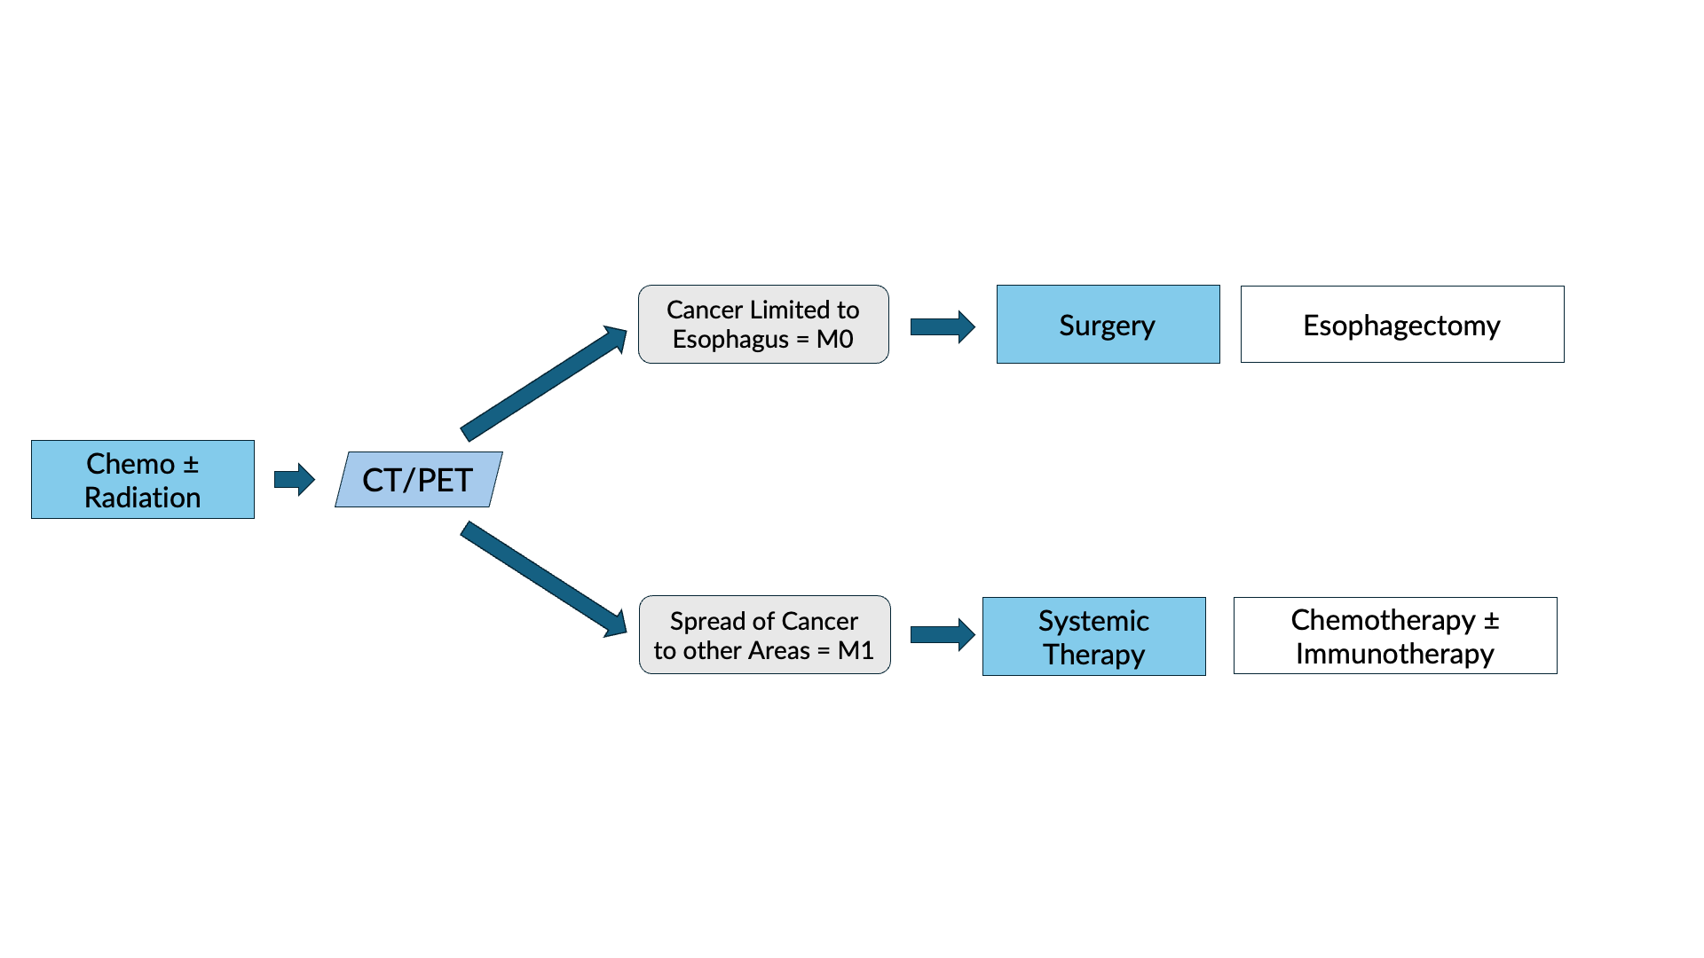
Restaging after Chemotherapy $±$ Radiation

Slide 45
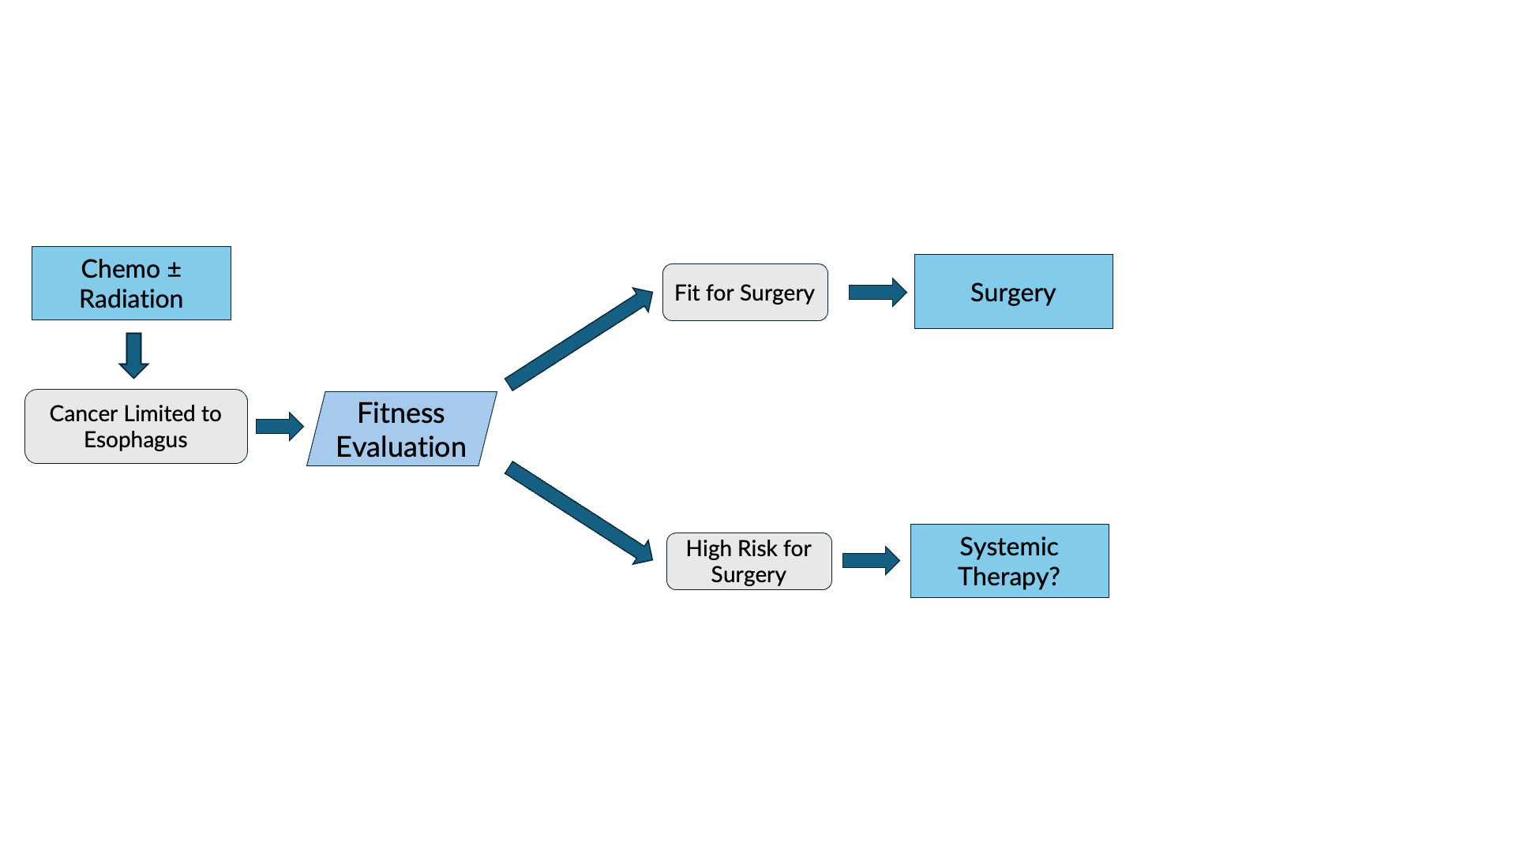
Fitness Evaluation prior to Surgery

Slide 46
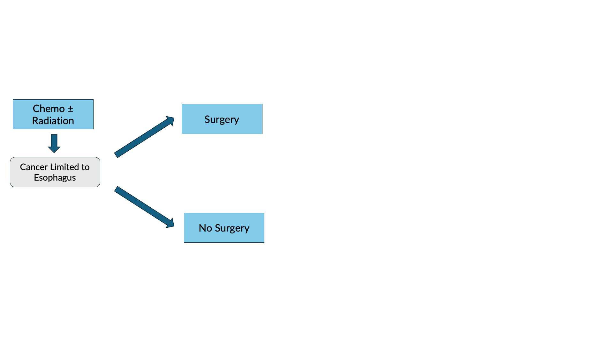
Surgery vs No Surgery

Slide 47
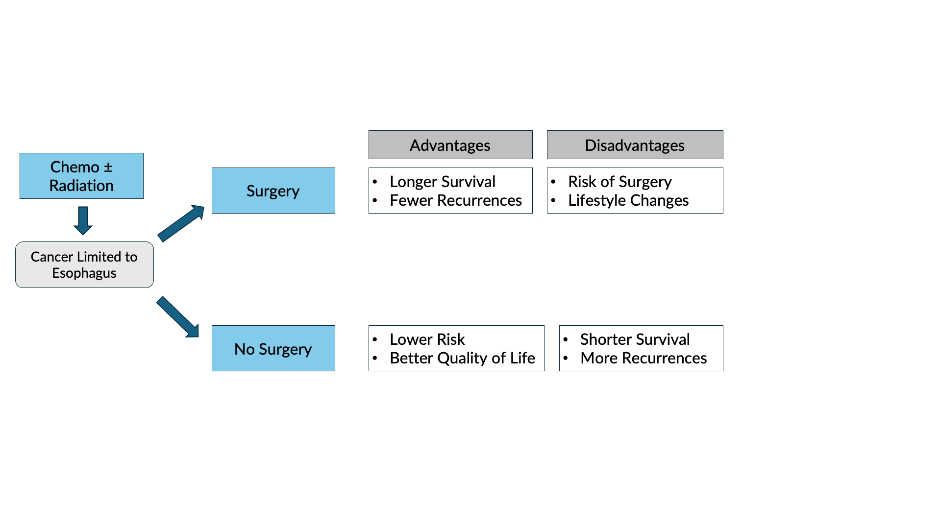
Surgery Advantages + Disadvantages

Slide 48
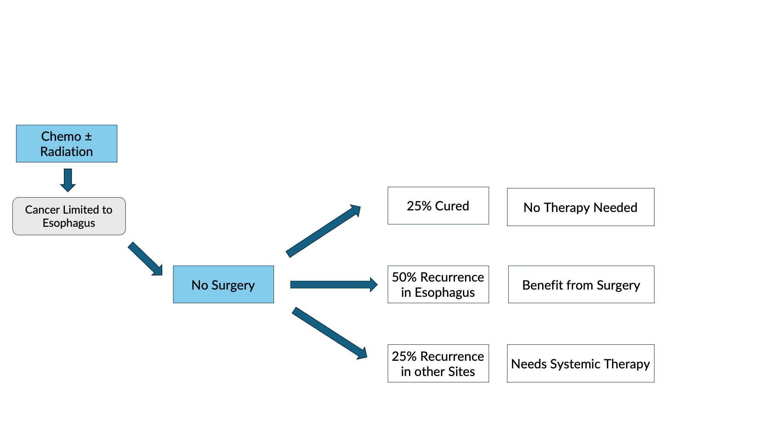
Outcomes after Chemotherapy $±$ Radiation

Slide 49
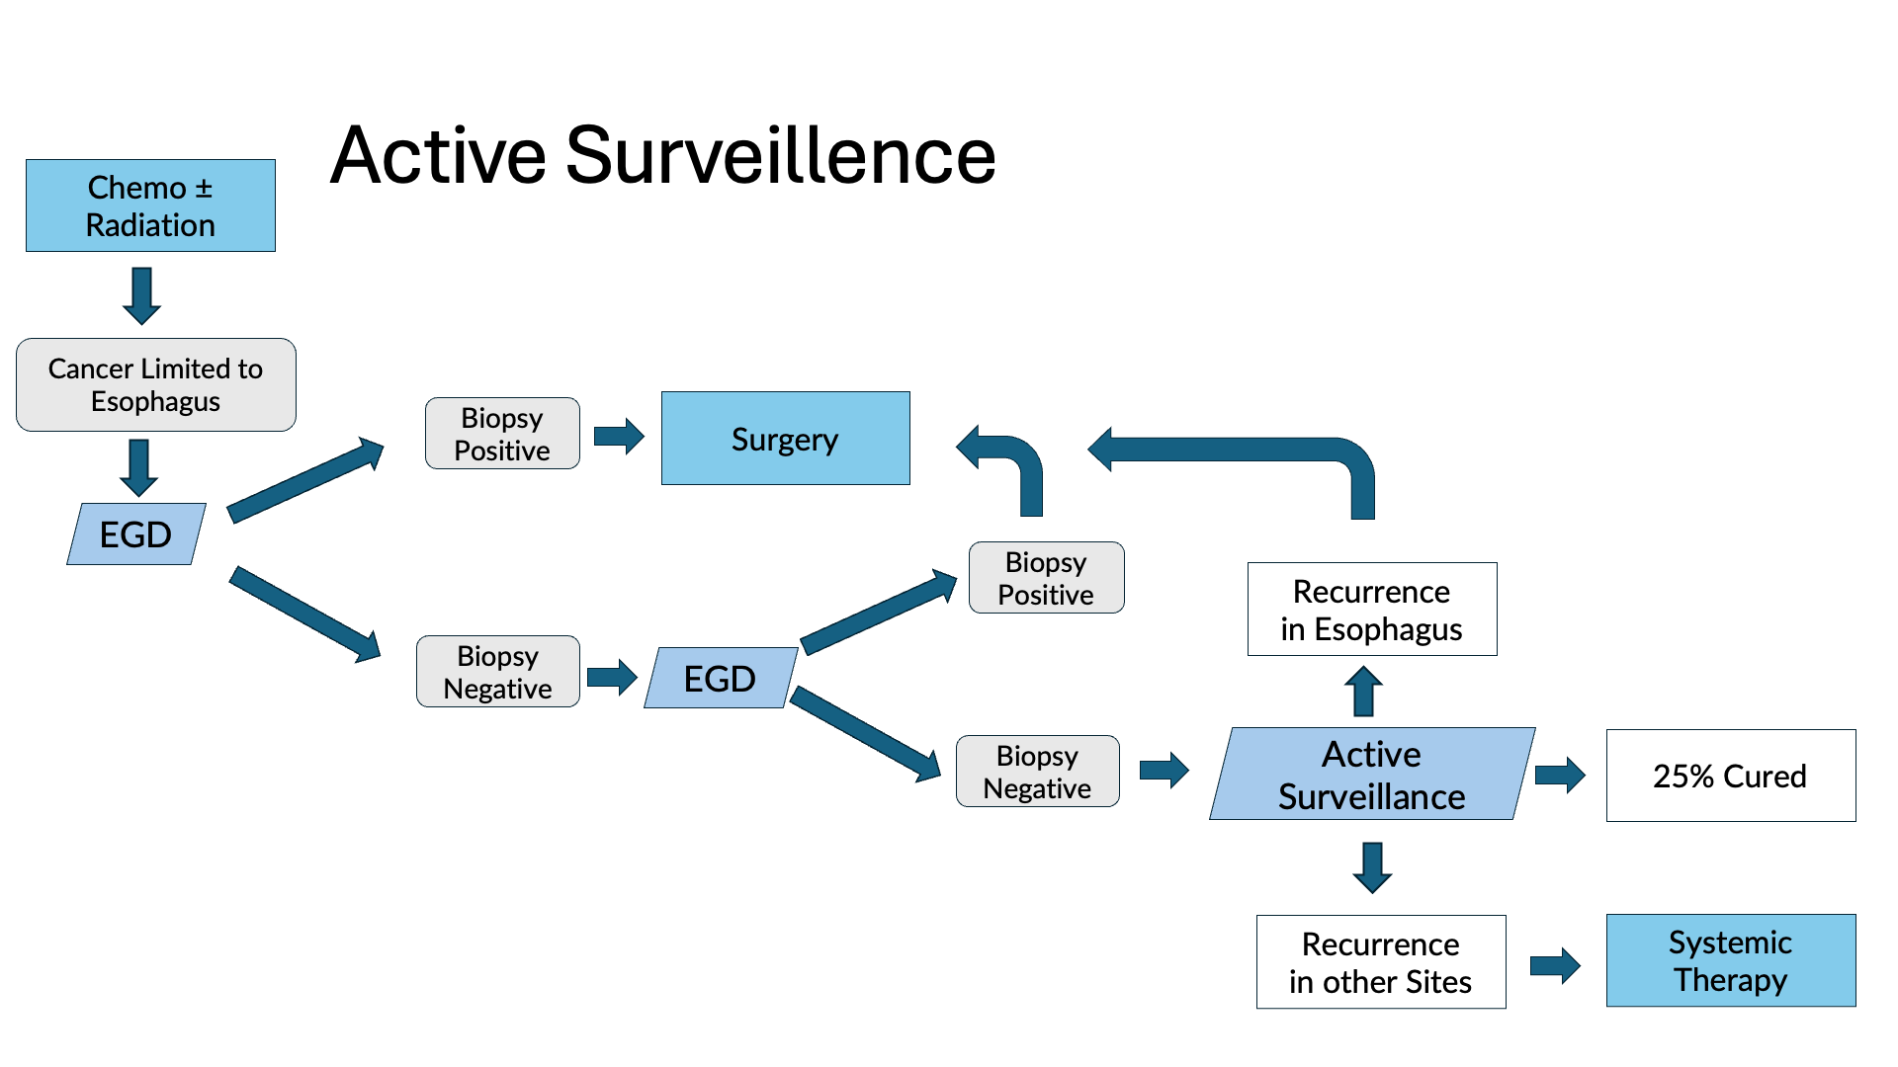

Slide 50
Active Surveillance
Active Surveillance is appropriate when:
CT/PET shows no signs of spread
EGD biopsies are negative
Active Surveillance reduces the need for surgery by 50% but survival and disease control is probably better with immediate surgery.

Slide 51
Primary Care Practitioner (PCP)
Critical to coordinate care between specialists.
We will update your PCP after each visit
PCP Referral Line (844) 235-6998

Slide 52
My Atrium Patient Portal
Critical to good communication with your care team
Available for desktop or laptop or phone
Sign up at my.atriumhealth.org

Slide 53
Exercise
Reduces risk of complications from treatment
Goal is 30min/day of vigorous exercise 6 days/wk
Working hard enough that you can’t converse
Start slowly and build up
Every day counts! (Aim for daily activity)

Slide 54
Smoking Cessation
Smoking makes cancer treatment more difficult
Increases risk of complications after surgery
Options for help with smoking cessation:
NC Quit Line 1-800-QUIT-NOW (1-800-784-8669)
American Lung Assn www.freedomfromsmoking.org
Smoking Cessation Counseling (Metro Charlotte)

Slide 55

Protein Needs
Men: Average 75 grams/day
Women: Average 60 grams/day
Protein Shakes provide protein with minimal sugar

Slide 56


Feeding Tubes

Slide 57
Gastrostomy Tube
Feeding Gastrostomy
Feeding with a syringe several times per day.
Tube can be hidden underneath clothing
Tube does not interfere with eating by mouth
Removed easily in the office when no longer needed

Slide 58
Gastrostomy Tube Methods
PEG: Tube placed by endoscopy
Laparoscopic: Tube placed surgically by laparoscopy
Preferred method depends upon whether esophagectomy is planned

Slide 59
Gastrostomy Tube
Outpatient Placement (go home the same day)
Central venous port can be placed at the same time (if needed)

Slide 60
Jejunostomy Tube
Nutrition to bypasses the esophagus and stomach
Placed in small intestine
Pump administers feedings slowly
Feeding done at night

Slide 61
Jejunostomy Typical Regimen
Jejunostomy tube feeds for 16 hours (6pm-10am)
Men: 75mL/hour x 16 hours = 5 cartons
Women: 60mL/hour x 16 hours = 4 cartons
Water 240ml (8oz) via syringe 4x/day
Hospital nurses will teach use of the feeding tube

Slide 62
Jejunostomy Feeds with Diabetes
Jejunostomy feedings elevate blood sugars
Insulin may be required along with feeds
Typical Pattern for tube feeds
Feeds run via pump from 6pm to 10am
Insulin at 6pm (70/30 insulin)
Insulin at Midnight (70/30 insulin)
No insulin if tube feedings are not run

Slide 63

Jejunostomy Video
A video is available to help become familiar with the feeding jejunostomy

Slide 64
Surgery for Esophageal Cancer
Surgery for esophageal cancer is performed for:
Superficial Tumors (T1) not removed by endoscopy
Localized Tumors (T2 N0 M0)
Locally Advanced (T3 M0) after preop therapy

Slide 65

Goals of Surgery
Remove tumor from esophagus
Remove surrounding lymph nodes
Create a new esophagus

Slide 66

Ivor Lewis (Transthoracic) Esophagectomy
Removes tumor and lower 1/3 esophagus
Removes surrounding lymph nodes
GI tract reconstructed

Slide 67

Reconstruction
New esophagus is created from the stomach in the abdomen by fashioning it into a tube.

Slide 68

Ivor Lewis esophagectomy
The new esophagus is now brought up into the chest. A connection is made between the esophagus and the stomach, called an anastomosis.

Slide 69

Minimally-invasive Ivor Lewis
Small incisions abdomen and chest
Surgical telescope and instruments
Smaller incisions $→$ faster recovery and less discomfort

Slide 70

Open Ivor Lewis
Mininally-invasive approach feasible in 95% of cases
In some cases, an open approach is still necessary.

Slide 71

Total Esophagectomy
For patients with tumors in the upper esophagus, we need to remove more of the esophagus
We need to remove the whole esophagus, including the portion in the neck

Slide 72


McKeown Esophagectomy

Slide 73

Colon Interposition
If the stomach is not suitable to make a new esophagus, the colon can be used to replace the esophagus

Slide 74

Colon Interposition

Slide 75
Risks of Esophagectomy
Esophagectomy is a complex operation, with a real risk of complications.
Two significant complications:
Anastomotic leak
Pneumonia

Slide 76
Anastomotic Leak
The anastomosis is surgical connection between the esophagus and the stomach.

Slide 77

Anastomotic Leak
If healing doesn’t occur:
Leakage of fluid from the esophagus
Infection in the space between the lungs
Requires additional time in the hospital

Slide 78
Anastomotic Leak
If leak occurs:
Some leaks will seal
Stent may be required to help healing
Occasionally additional surgey is required

Slide 79
Anastomotic Leak
Risk of leak depends on:
Type of operation performed
Nutritional status of patient
Experience of the surgeon

Slide 80

Pneumonia
Occurs in 10-15% of patients after esophagectomy.
Requires treatment with antibiotics
Requires a longer hospitalization.

Slide 81
Preventing Pneumonia
Several ways to help prevent pneumonia:
Deep breathing
Coughing
Walking
After surgery, this means:
Sitting in a chair most of the day
Walking in the halls as soon as possible

Slide 82


Minimally-invasive Esophagectomy

Slide 83
Risks of Surgery
Risks related to anesthesia
Heart attack (5%)
Irregular heart rhythm (15%)
Pneumonia (10%)
Blood clots in legs (<5%)
Pulmonary embolism (2%)

Slide 84
Risks of Surgery
Risks related to Surgery
Anastomotic leak (5%)
Stricture at anastomosis (15%)
Death within 90 days of surgery
Low risk patients = 2%
Intermediate risk = 10%
High risk = 30%

Slide 85
Risks of Surgery
 | Age <75 | Age >75
Normal Muscle (75%) | 2% | 10%
Low Muscle (25%) | 10% | 30%
Risks of Death within 90 Days of Surgery

Slide 86
Day Prior to Surgery
Clear liquids for 24 hours prior to surgery
Check with Pre-op nurse regarding medicines day prior to surgery
No tube feedings the night before surgery

Slide 87
Day of Surgery
Arrive at 5am – nothing to eat or drink after midnight.
Medicines OK w/ a sip of water
sip of black coffee but no cream.
Surgery will be cancelled if you have cream/milk
Waiting room for family and friends on 5th floor

Slide 88
Epidural Catheter for Pain Control
Remains in place for 2-5 days
Dosage can be adjusted as needed
Can make it more difficult to urinate
May require foley catheter in bladder
Foley catheter removed after epidural removed

Slide 89
Intensive Care Unit (ICU) (2-4 days)
Surgical ICU on 11th floor
NG tube in nose to drain stomach and esophagus
Catheter in bladder
Chest tube right chest
Abdominal drains (usually 2)
Feeding jejunostomy (usually stays in 8 wks)

Slide 90
Intensive Care Unit (ICU)
Bladder catheter removed → check that bladder empties properly
Chest tube removed (day 2-4) → follow-up x-ray
Fluid emptied from drains every few hours
Start tube feedings by feeding
Feeding jejunostomy (stays in 8 weeks)

Slide 91
Ward - 6Tower
Jejunostomy feeds started
Up in a chair most of the day
Walking in the halls
Start with assistance
Improves lung function
Prevents loss of muscle strength

Slide 92
Jejunostomy Feeds
Jejunostomy tube feeds
Start continuous (24 hours)
Convert to night-time only (16 hours)
Water administered through feeding tube
Usually 8oz 4 times/day
Important to prevent dehydration

Slide 93
Jejunostomy Tube
Nutrition to bypasses the esophagus and stomach
Placed in small intestine
Pump administers feedings slowly
Feeding done at night

Slide 94
Jejunostomy Typical Regimen
Jejunostomy tube feeds for 16 hours (6pm-10am)
Men: 75mL/hour x 16 hours = 5 cartons
Women: 60mL/hour x 16 hours = 4 cartons
Water 240ml (8oz) via syringe 4x/day
Hospital nurses will teach use of the feeding tube

Slide 95
Jejunostomy Feeds with Diabetes
Jejunostomy feedings elevate blood sugars
Insulin may be required along with feeds
Typical Pattern for tube feeds
Feeds run via pump from 6pm to 10am
Insulin at 6pm (70/30 insulin)
Insulin at Midnight (70/30 insulin)
No insulin if tube feedings are not run

Slide 96
Jejunostomy Video
A video is available to help become familiar with the feeding jejunostomy

Slide 97
Activity after Surgery
Up in chair most of the day
Walking with help from nurse/Physical Therapist
Goals:
Improve lung function
Prevent muscle loss

Slide 98
Nasogastric (NG) Tube
Tube passed through nose into stomach
Drains fluid from stomach
Prevents vomiting
Upper GI X-ray on 2nd or 3rd day after surgery
If stomach empties well $→$ NG tube removed
Otherwise, X-ray repeated 2-3 days later

Slide 99
Swallowing Evaluation
Once NG tube has been removed:
Modified barium swallow in radiology
Drink a white chalky liquid (barium)
Look for proper swallowing function
70% of patients $⇒$ liquids started by mouth

Slide 100
Oral Intake at Home
Most are taking protein shakes when they go home
Protein shakes are started after tolerating water
2 oz per hour to start
4 oz per hour if 2oz are tolerated well

Slide 101
Discharge
Goal: ready to leave day #6/7 after surgery
Night-time tube feedings (6pm to 10am)
Nutrition by mouth (70% of patients)
1 oz of water per hour by mouth OR
Protein shakes 4oz every 2 hours
Water through tube 8oz four times per day
Home care nursing (feeding tube teaching)
Home infusion (tube feeding supplies)

Slide 102
Nutrition after Surgery
At discharge home:
Protein shakes 4oz every 2 hrs
Tube feeds 4-5 cans at night (6pm-10am)
10-12 Days: Increase protein shakes
Tube feeds 3-4 cans at night
Three weeks: Post-esophagectomy Diet
8-12 weeks: Remove feeding tube (in office)

Slide 103
Transition from Tube Feeds $→$ Eating
Dietitian will calculate daily protein goal
Typically 60-75 grams protein/day
Each carton of tube feeding has 15 grams
75 grams protein = 5 cartons/night
More intake by mouth $→$ tube feeds reduced
Spread out protein during the day (20gm/meal)
Three meals + 2-3 high-protein snacks

Slide 104
Post-esophagectomy Diet
Soft Consistency
High Protein
Avoid sugary liquids (can cause ‘dumping’)
Avoid raw vegetables (and salads)
Eating
Small, frequent meals
Sit up for 30-45 minutes after eating
Avoid eating within 2 hours of bedtime

Slide 105
Medicines at Home - Pain
Acetaminophen (Tylenol) 1000mg 4x/day
Gabapentin 300mg 3 times/day
Oxycodone
As needed in addition to Tylenol/gabapentin
Will begin reducing dose at first postop visit
Can usually discontinue by 4 weeks
NO DRIVING WHILE ON OXYCODONE

Slide 106
Non-steroidals Anti Inflammatory (NSAID)
Non-steroidal anti-inflammatories (Celebrex)
200 mg every 12 hours starting at 2 weeks
NO GOODY POWDERS OR BCs
(Can cause permanent scarring at the surgery site)

Slide 107
Acid Blockers = Proton Pump Inhibitors
Examples include ompeprazole and pantoprazole
Will stay on for at 1-2 years to prevent acid reflux
Important in preventing scarring at anastomosis (new connection between esophagus and stomach)
To administer through feeding tube, open capsule and resuspend beads in 60mL (2oz) of water

Slide 108
Medicines at Home
Reglan – Helps stomach empty
Will plan to stop after six weeks
0.1% risk of tardive dyskinesia (nervous tic)
Remeron – Helps improve appetite
Can cause vivid dreams
Used for several weeks after surgery
Will stop within first three months of surgery

Slide 109
Metoprolol = Beta Blockers
Slows heart rate and lowers blood pressure
Used to prevent rapid heart rate
Patients not taking a beta blocker prior to surgery $→$ wean after after surgery
Patients taking a beta blockerprior to surgery $→$ return to prior dose and drug after surgery

Slide 110

Sleeping at Home
Reflux can occur the first few weeks/months after surgery
This improves over the first few months
A wedge pillow can be helpful for sleep

Slide 111
Postoperative Visit at 7-10 Days
Check surgical site
Remove staples (if needed)
Adjust medicines as needed
Insulin (for diabetic patients on insulin)
Reduce beta blocker medicines
Advance diet
Reduce tube feeds

Slide 112
After surgery
Wean off medicines added after surgery
Pain medicines
Beta-blockers
Reglan and Remeron
Continue acid blockers for at least 1 year

Slide 113
Jejunostomy Removal
Jejunostomy tube is removed in the office once you can take in enough nutrients by mouth
Removal usually around 8 weeks after surgery
May take 30 minutes and some local anesthetic to loosen up the tube for removal.

Slide 114
Nutritional Monitoring after Surgery
You may have difficulty absorbing some nutrients:
Iron
Vitamin B12
Vitamin D

Slide 115
Nutritional Monitoring after Surgery
About 3 months after the jejunostomy tube is removed, we will check blood levels:
Iron (ferritin)
Vitamin B12
Vitamin D

Slide 116
Nutritional Replacements after Surgery
Vitamin or iron replacements can be ordered by:
Primary Care Provider (PCP)
Medical Oncologist
Surgeon
If levels are low
Replacement
Repeat testing in 3-6 months

Slide 117
Team Members - Physicians
Primary Care Provider
Gastroenterologist
Medical Oncologist (chemotherapy)
Radiation Oncologist (radiation)
Surgeons
Jonathan Salo
Jeffrey Hagen
Michael Roach

Slide 118
Team Members - Support Staff
Dietitian - Liz Koch
Nurses - Brandon Galloway - Kit Sluder - Sarah Ezell - Rebecca Wicks
Navigator - Laura Swift

